Slide 1
Case study: concussion
Caroline Podvin-3-HB

Slide 2
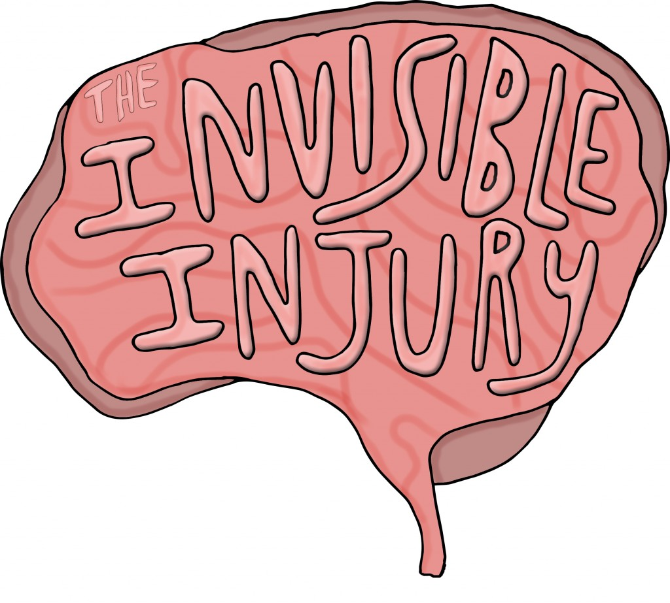
Injury-evaluator’s perspective
“A complex pathophysiological process affecting the brain caused by a traumatic physical force of impact to the head or body”
Symptoms:
Fogginess
Headache
Dizziness
Sluggish
Notes:
Pathophysiological→ physical disease, “functional changes of a disease”

Slide 3
Mechanism of Injury
Direct blow to head
Elbowed in left Temporal lobe
Hit by basketball on Occipital lobe

Slide 4
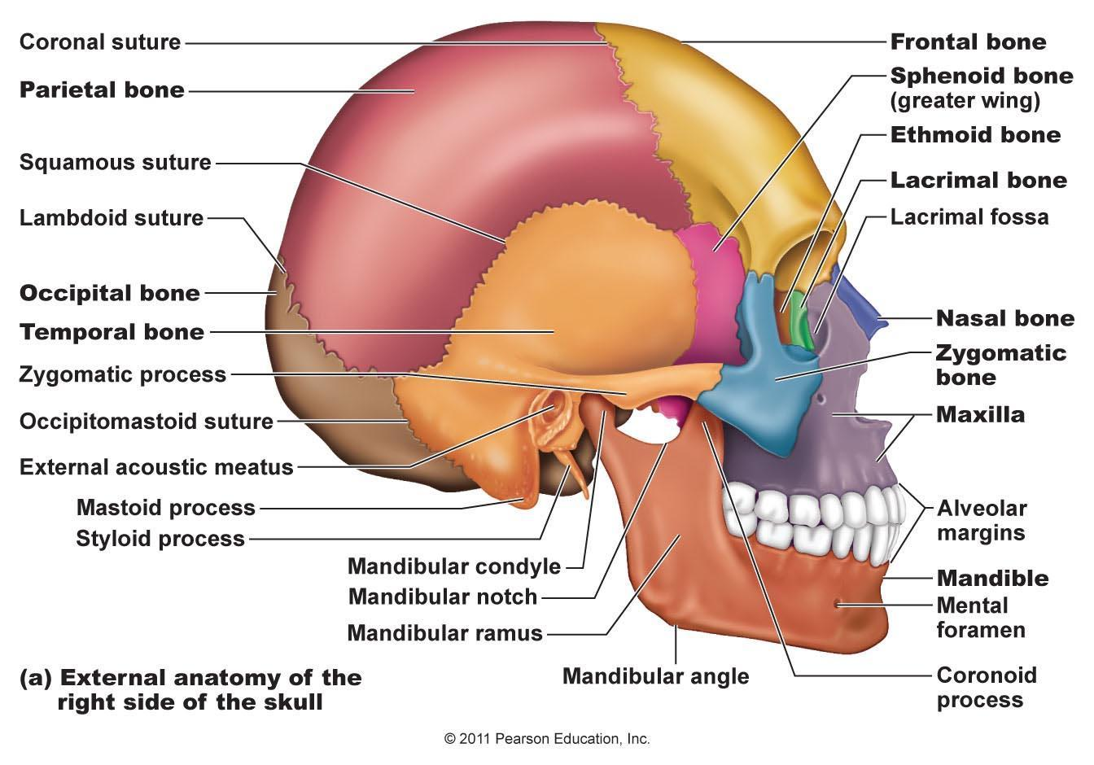
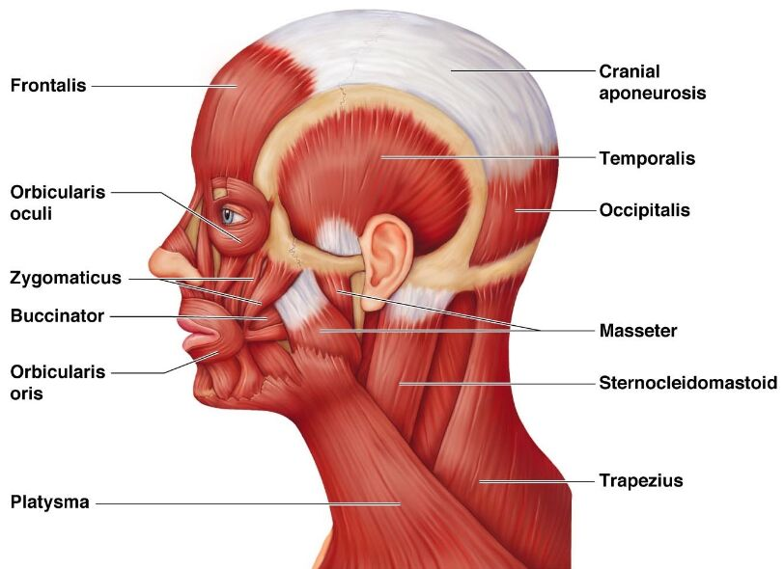
Involved structures
Primary:
Temporalis muscle
Left temporal bone
Occipitalis muscles
Occipital bone

Slide 5
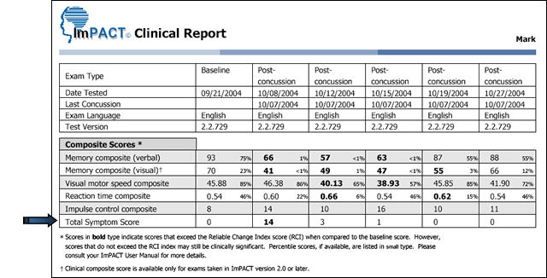
Special test
Written
imPACT- positive when failed test
SCAT 5-positive when failed
Active
BESS- positive when failed
Notes:
impact–
SCAT5– symptoms
BESS– balance and physical impairments

Slide 6
SOAP NOTe
Subjective:
Athlete was playing basketball, waiting for the rebound when she was elbowed in the left temple. Later in the game, a basketball hit her in the Occipital lobe. She felt very confused, dizzy, and tired. She did not remember walking home that night. Headache was at 6/10 for the entirety of the night. I had 2 diagnosed concussions, but other undiagnosed ones.
Objective:
That night, her balance was terrible and she slept for the rest of the night after getting home. The next day, she couldn’t spell her name and didn’t know who the president was. She didn’t have a baseline impact test, but she took a test days later. At school, a nurse gave her a BESS test and asked about symptoms. The nurse told her to go home and see Dr. Roger Sterling.
Assessment:
Grade III Concussion.
Plan:
No school until no symptoms
Physical therapy for restoring balance and equilibrium
No screens
Rest and sleep
Then follow return to play
Notes:
Did not feel like myself for months, lasting problems → enhanced dyslexia/add

Slide 7
treatment
Rest, sleep
Gradual return to classroom
Physical therapy
Return to play (didn’t play for the rest of the school year)
This Photo by Unknown Author is licensed under CC BY

Slide 8
referral
Dr. James Sterling - A board certified sports medicine, sports medicine concussion and conservative spine specialist.
MRI- Check that there’s no fluid or anatomical problems
Told to rest
Returned every few months for imPACT test

Slide 9
Ursuline’s return policies

Slide 10
Sources
Brown, Charlotte. “FCPS Making A Stand For Safety.” THE HAWKEYE, uhshawkeye.com/sports/2016/12/02/fcps-making-a-stand-for-safety/.
“Concussion....now What?” BREAKTHRU Physical Therapy & Fitness, 28 Apr. 2017, breakthruptfitness.com/concussion-now-what/.
“Concussion Testing.” Mayo Clinic, Mayo Foundation for Medical Education and Research, 3 Jan. 2018, www.mayoclinic.org/tests-procedures/concussion-testing/about/pac-20384683.
“Pathophysiology.” Merriam-Webster, Merriam-Webster, www.merriam- webster.com/dictionary/pathophysiology.

